Slide 1

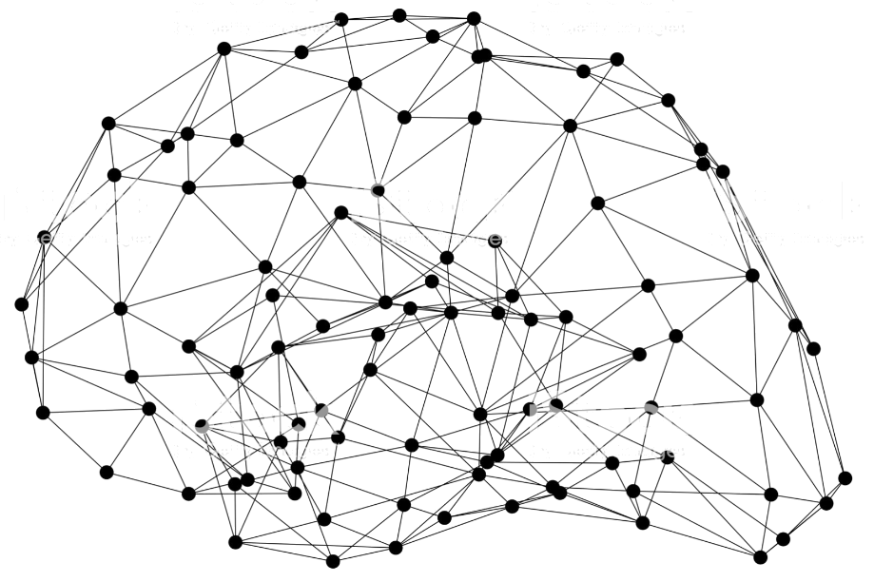
GluonCV: Segmentation
Notes:
First call deck for a high level introduction to Apache MXNet.

Slide 2
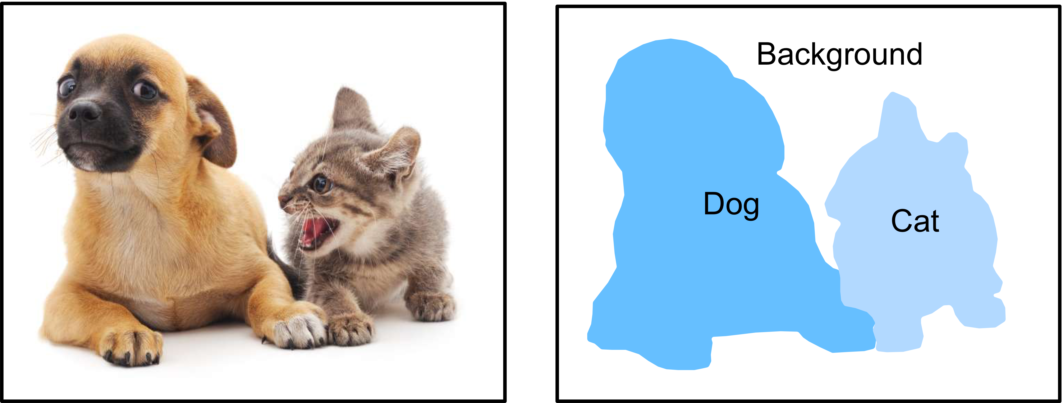
What’s segmentation
Classify and mask the pixels of the object

Slide 3
Why Segmentation?
Precise information

Slide 4
Popular categories of segmentation
Semantic Segmentation
Instance Segmentation

Slide 5
Popular models of segmentation
Semantic Segmentation
Instance Segmentation
FCN
PSPNet
DeepLab v3
Mask R-CNN

Slide 6
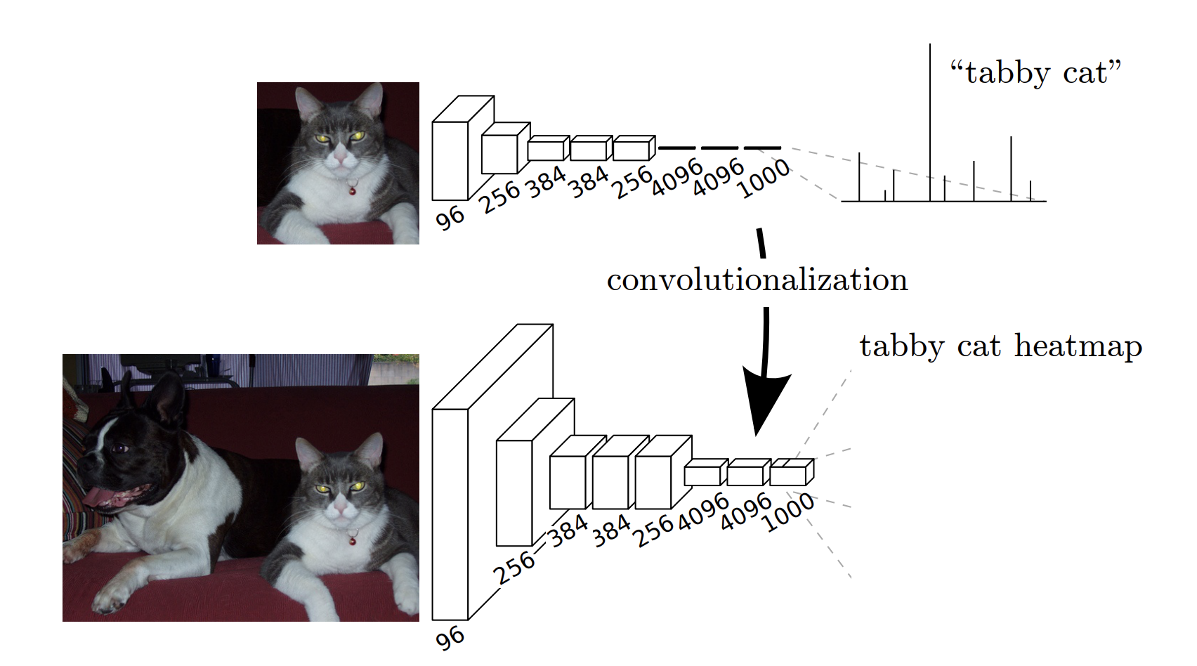
Implement SOTA Semantic Segmentation Models
FCN: Fully Convolutional Network

Slide 7
Implement SOTA Semantic Segmentation Models
FCN: Fully Convolutional Network

Slide 8

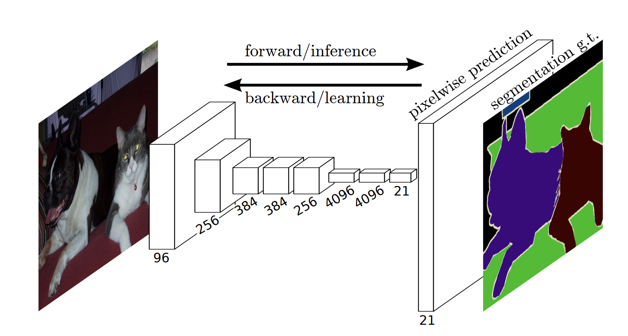
Implement SOTA Semantic Segmentation Models
Upsampling: small to large feature map

Slide 9


Implement SOTA Semantic Segmentation Models
Normal
Dilated
Dilated Convolution: increase receptive field

Slide 10
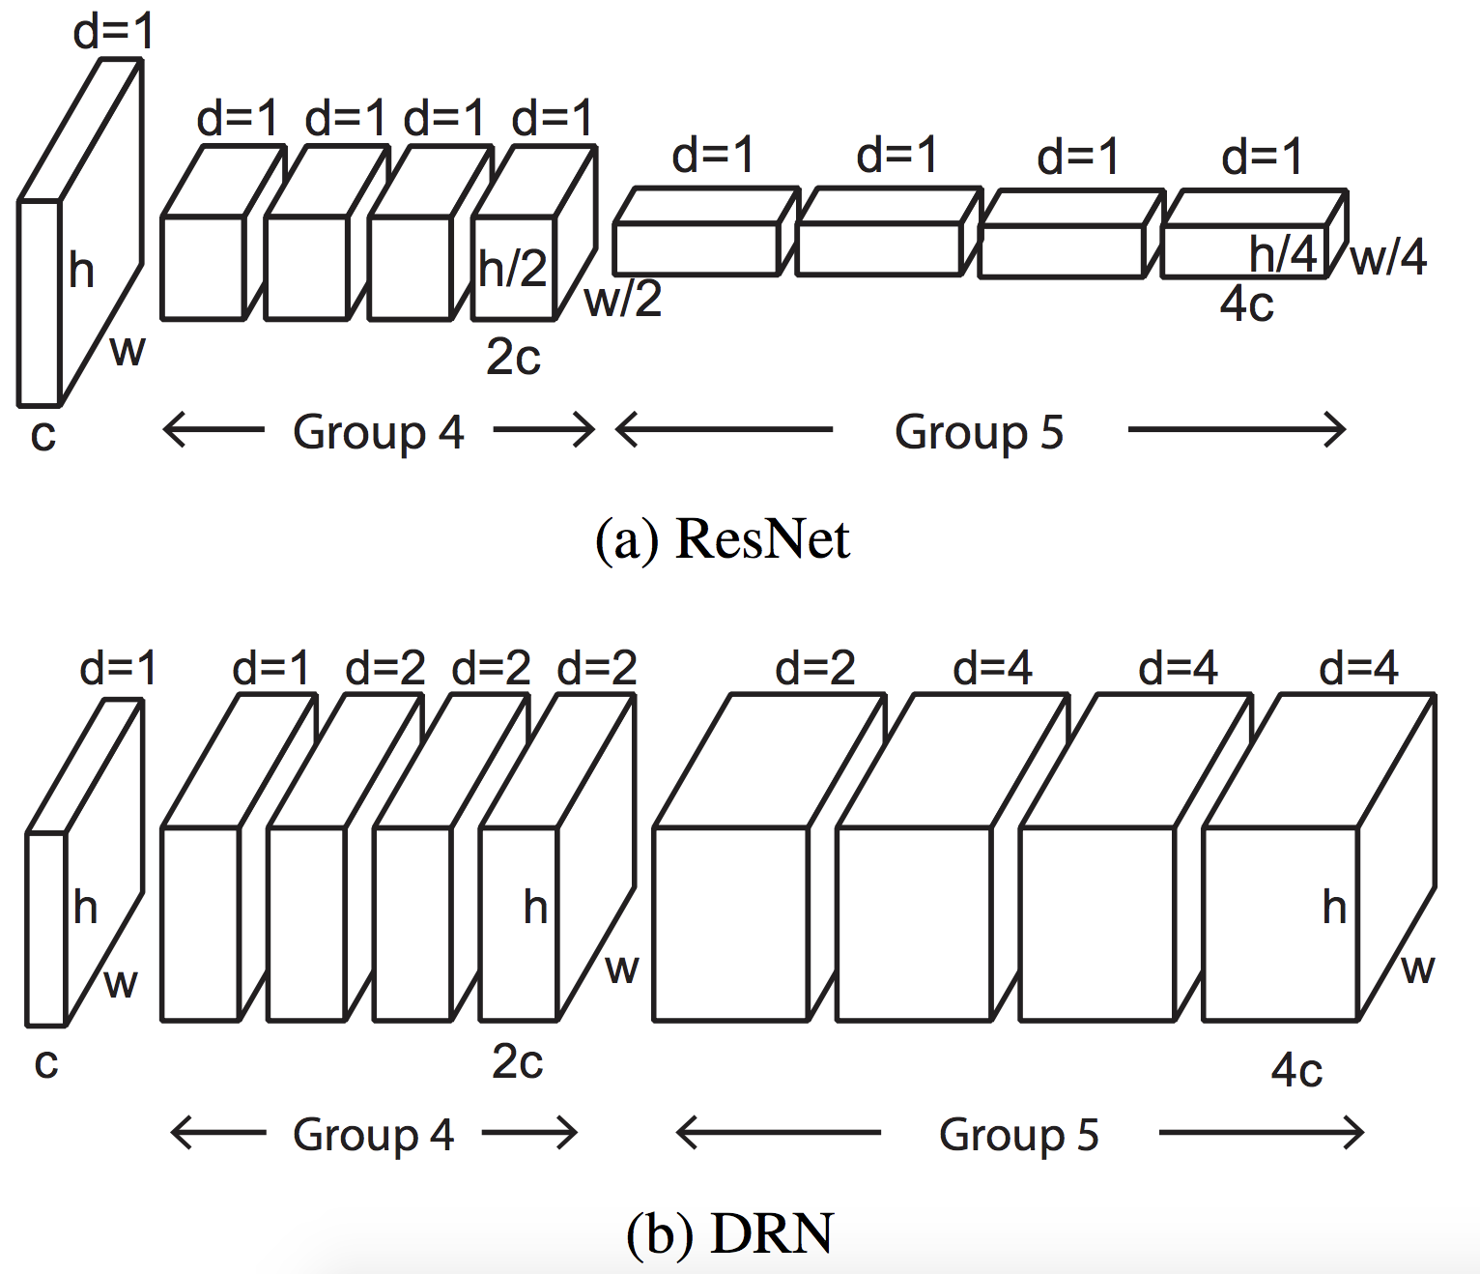
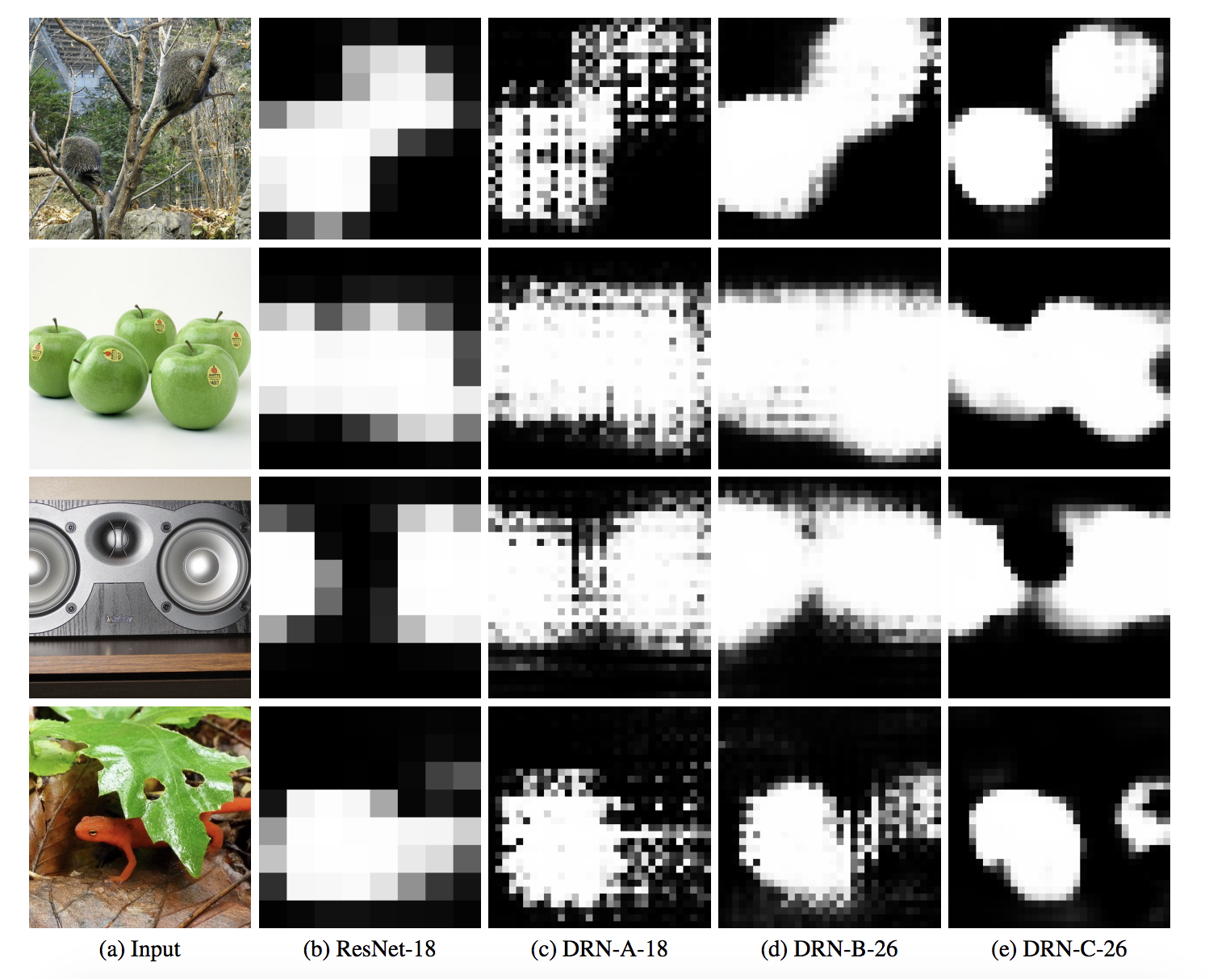
Implement SOTA Semantic Segmentation Models
Dilated Residual Network

Slide 11
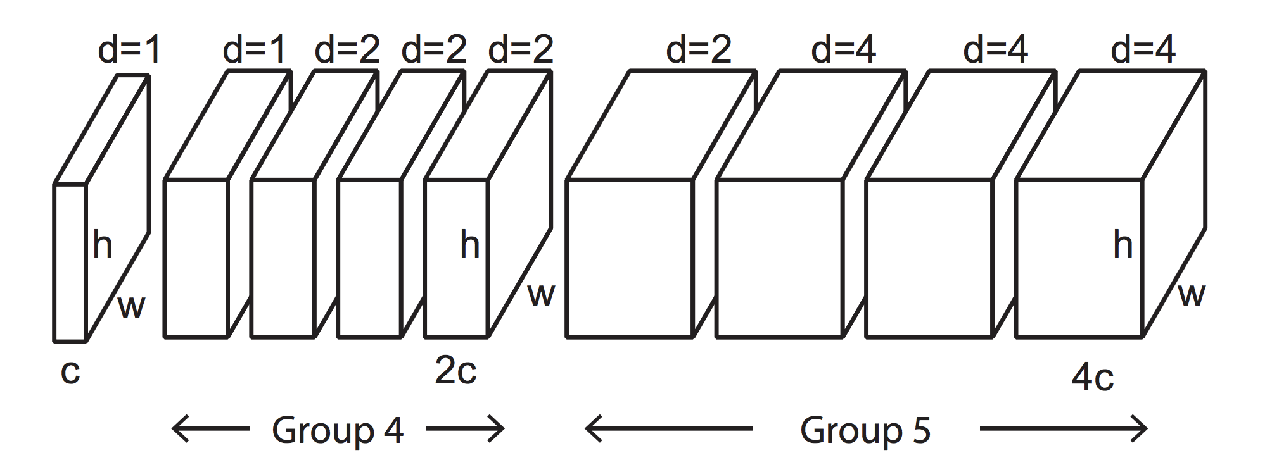
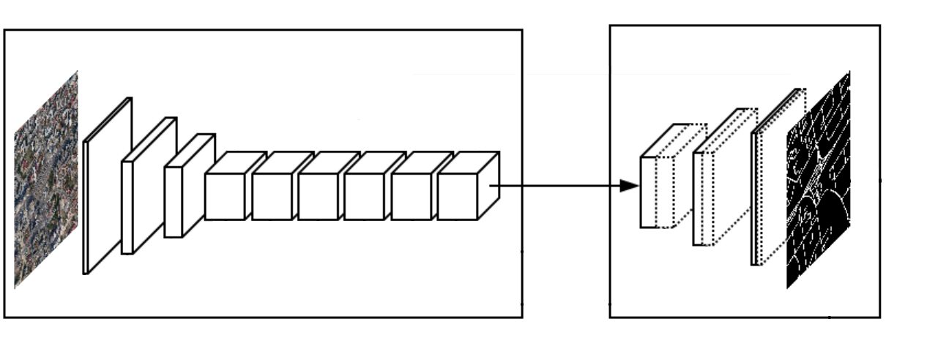
Implement SOTA Semantic Segmentation Models
FCN + Dilation

Slide 12
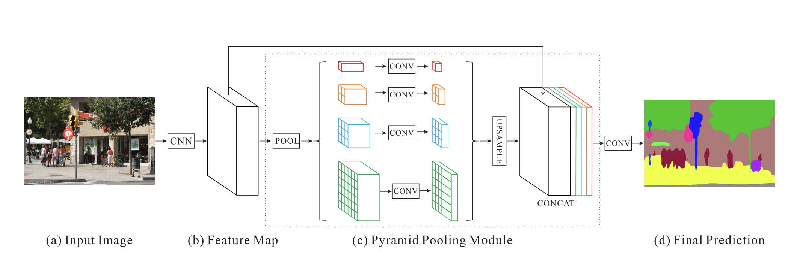
Implement SOTA Semantic Segmentation Models
PSP: Pyramid Scene Parsing Network

Slide 13
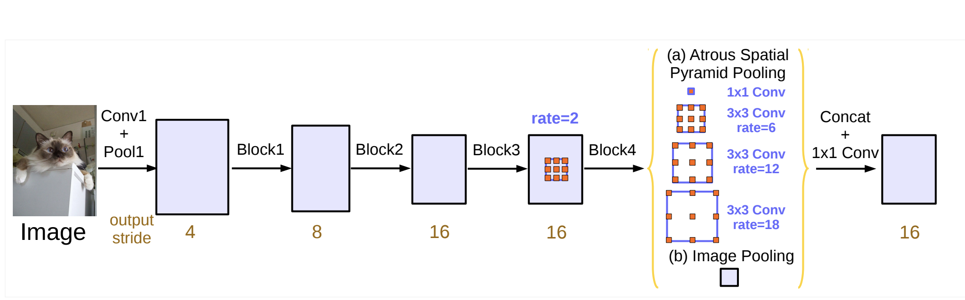
Implement SOTA Semantic Segmentation Models
DeepLab v3

Slide 14
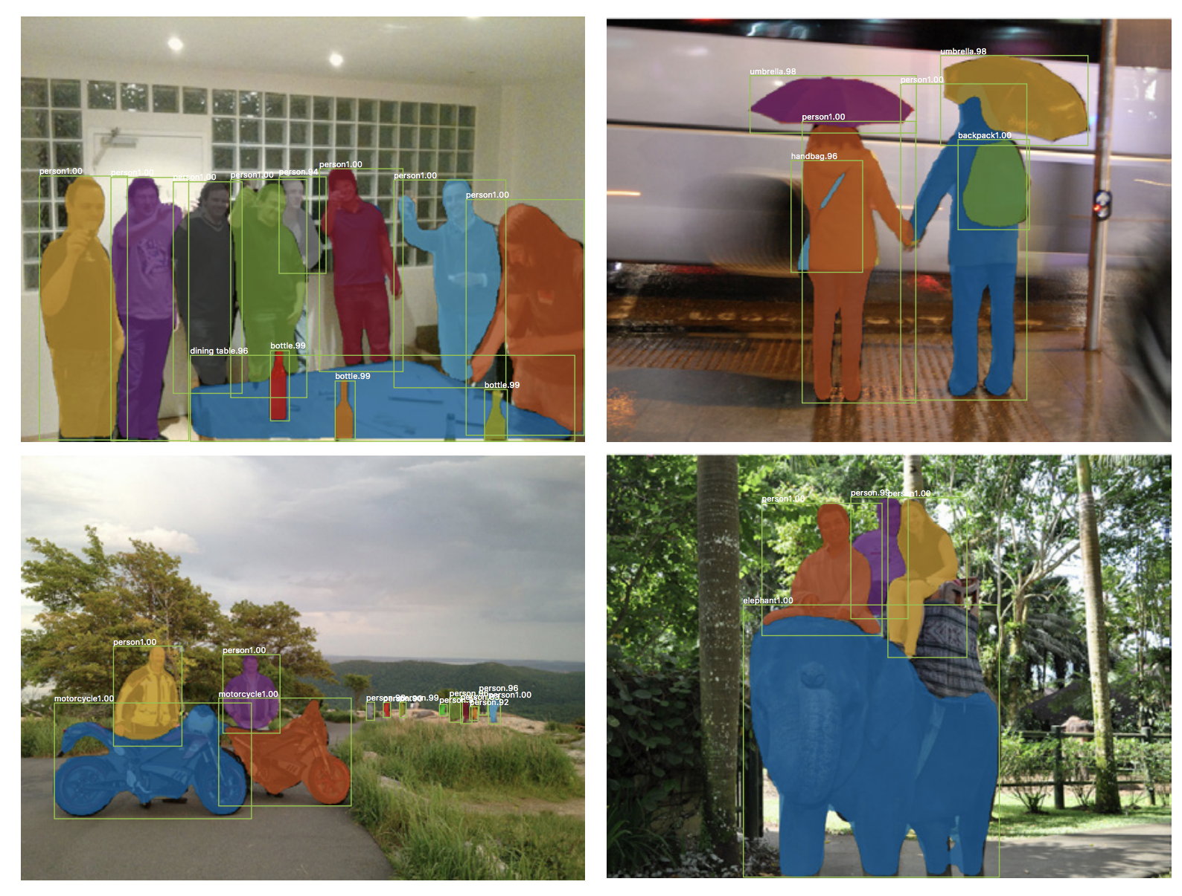
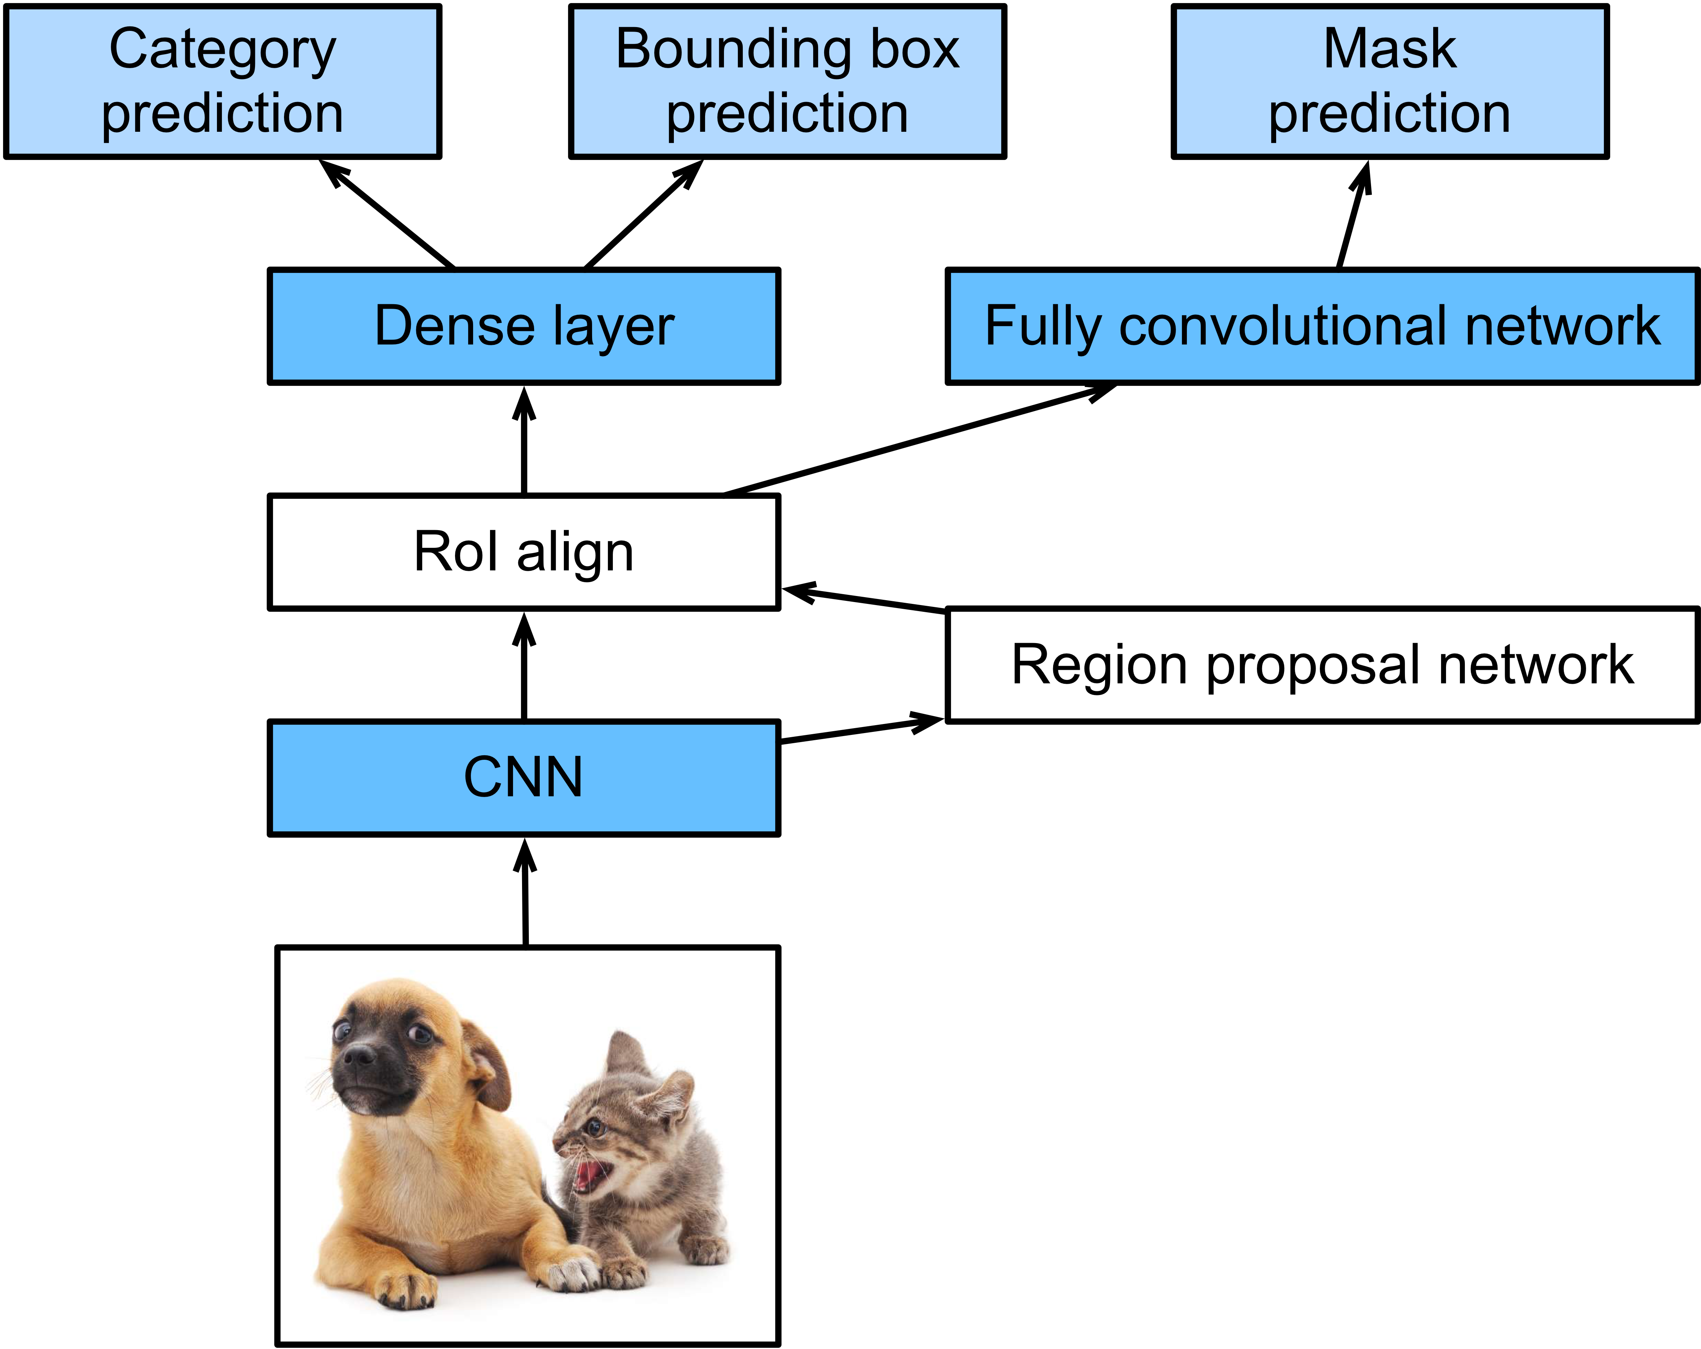
Implement SOTA Instance Segmentation Models
Mask R-CNN

Slide 15
Implement SOTA Segmentation Models with GluonCV
Method | Metric | GluonCV | Reference
DeepLab-v3 | mIoU on VOC | 86.7% | 85.7%(paper)
Mask-RCNN-ResNet50 | Mask AP on COCO | 33.1% | 32.8%(Detectron)
Mask-RCNN-Resnet101-FPN | Mask AP on COCO | 37.7% | 36.4%(Detectron)
SOTA pre-trained models

Slide 16
Implement SOTA Segmentation Models with GluonCV
Data API
Automated data preparation
Dataset specialized for Segmentation
Transformation API
Metric API
Loss API
Pre-defined network architectures
Building-blocks
Custom Layers
Reproducible Experiments
Training Script
Configurations
Available in GluonCV

Slide 17
Implement SOTA Segmentation Models with GluonCV
Images and Ground Truths

Slide 18
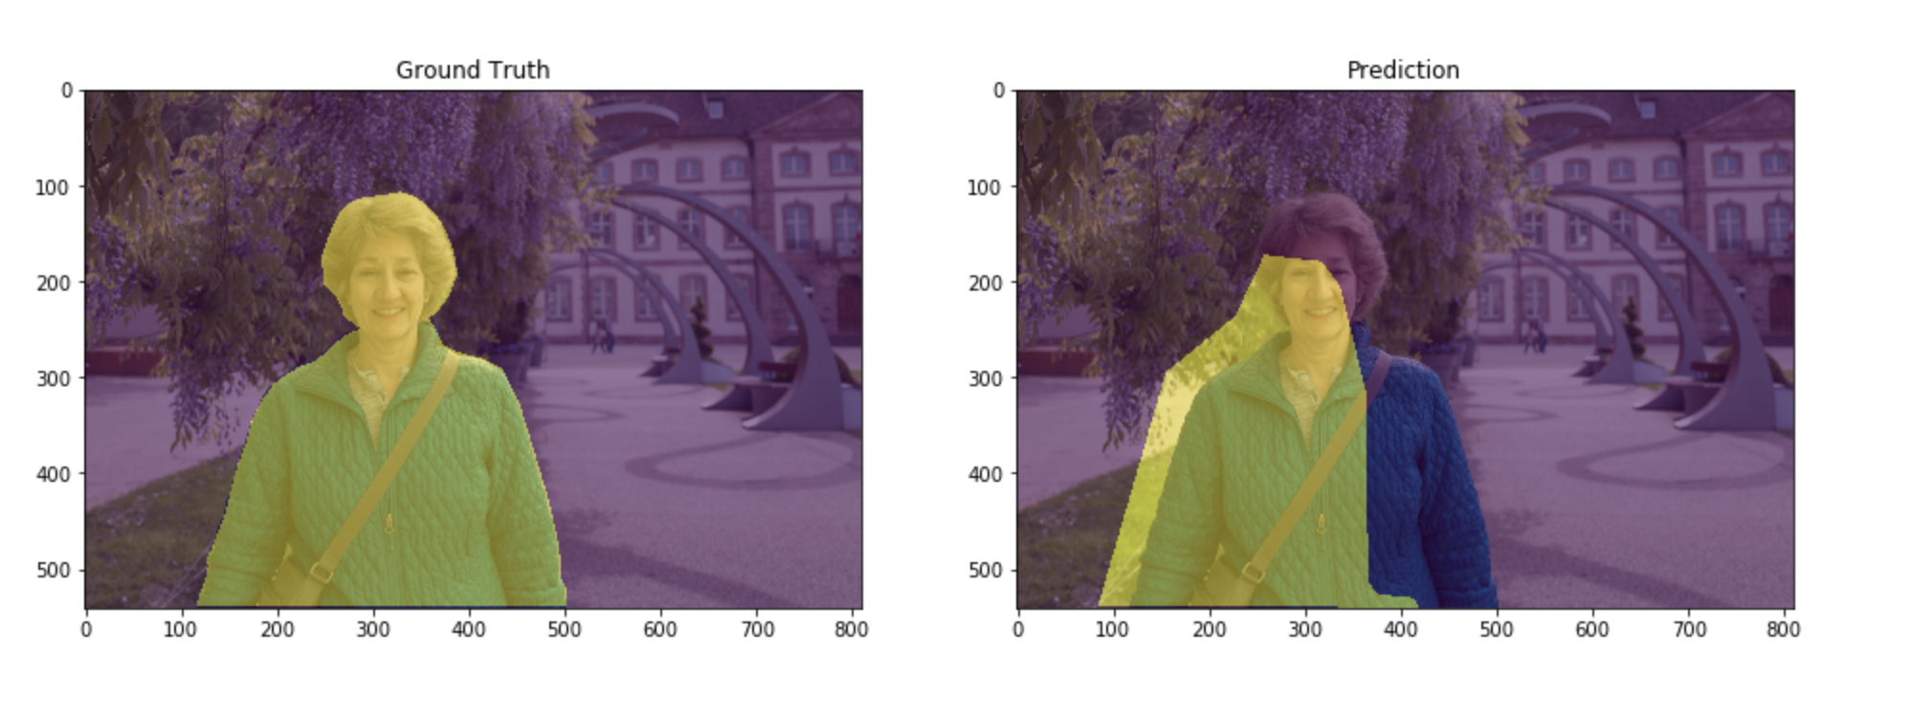
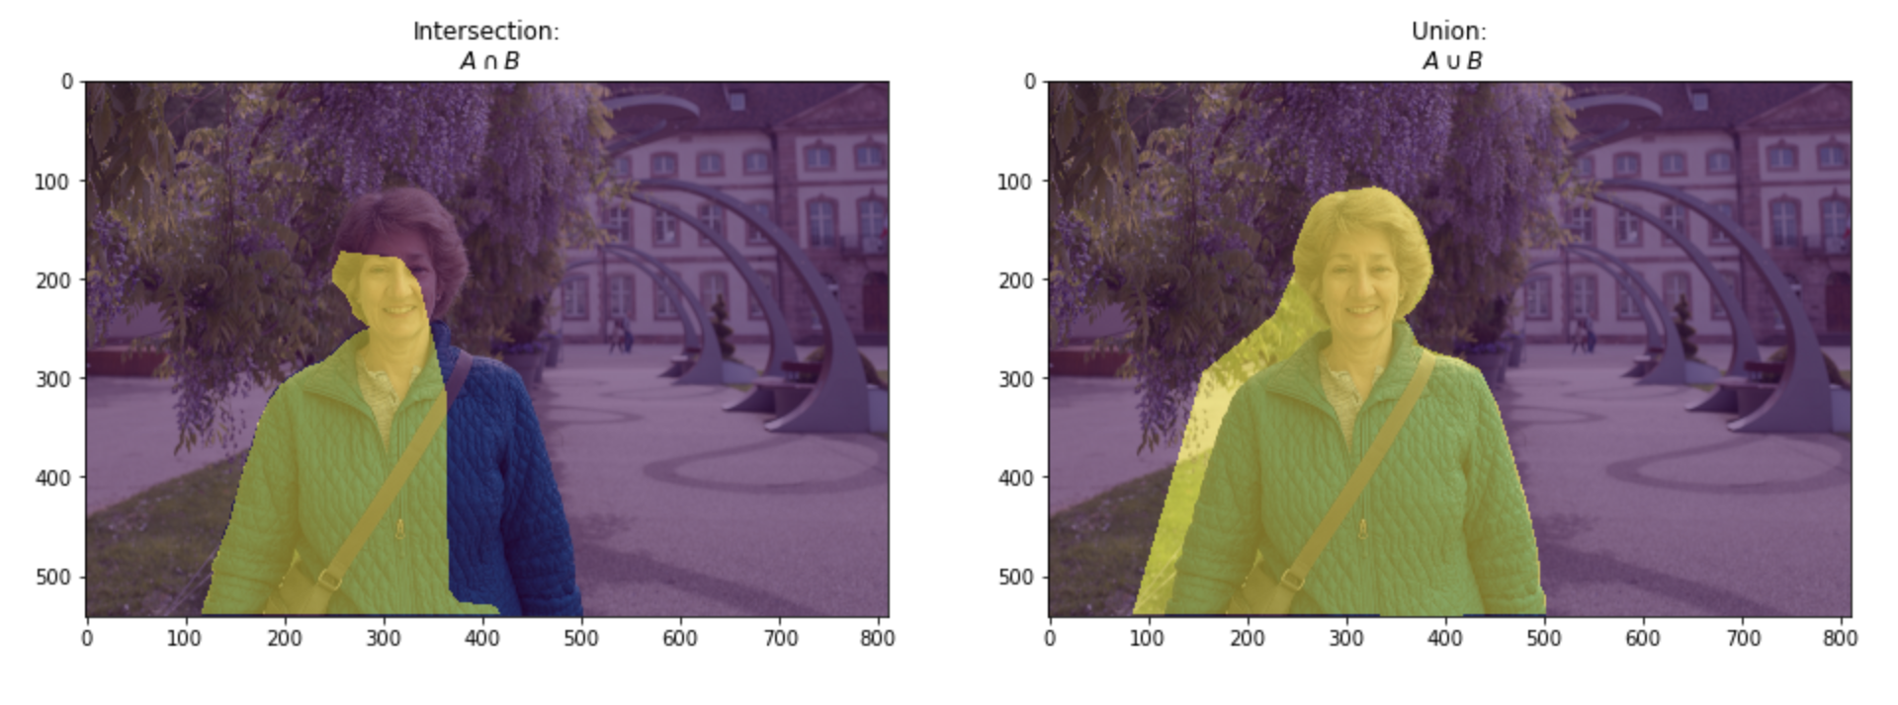
Implement SOTA Segmentation Models with GluonCV
Metrics
PixAcc
mIoU

Slide 19
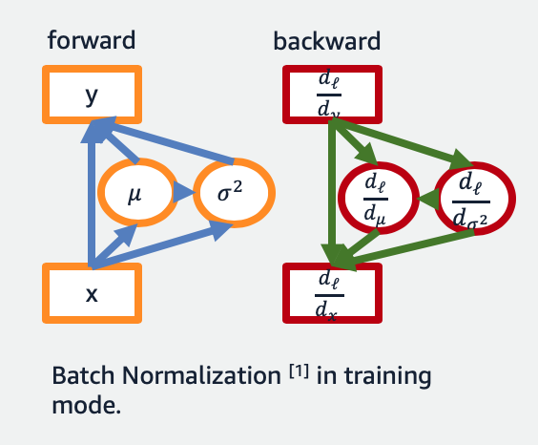
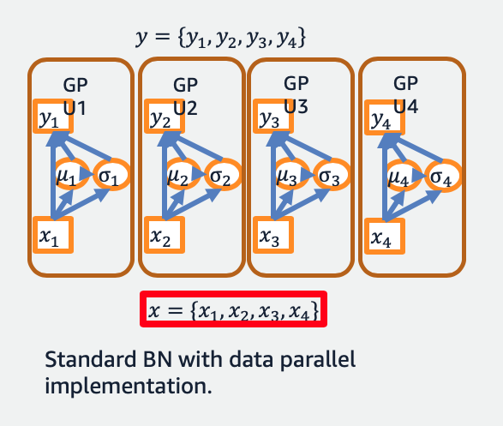
Implement SOTA Segmentation Models with GluonCV
Standard BN and Data Parallelism
¹Ioffe and Szegedy. "Batch normalization: Accelerating deep network training by reducing internal covariate shift.” ICML. 2015.
Notes:
Sync-BN is critical for Semantic Segmentation tasks due to the nature that the memory consumption is higher and therefore effective batch-size on each GPU is smaller.

Slide 20
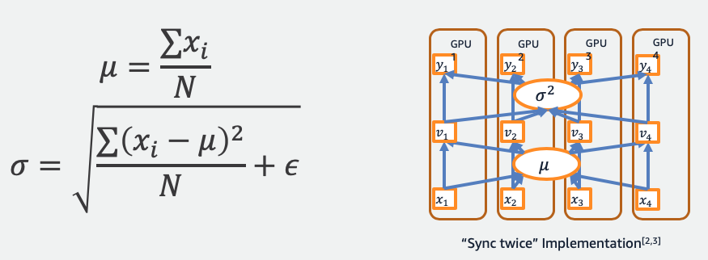
Implement SOTA Segmentation Models with GluonCV
Synchronized BatchNorm(”Sync twice”)
²Peng, Chao, et al. "MegDet: A Large Mini-Batch Object Detector.” CVPR2018
³Liu, Shu, et al. "Path Aggregation Network for Instance Segmentation.” CVPR2018

Slide 21
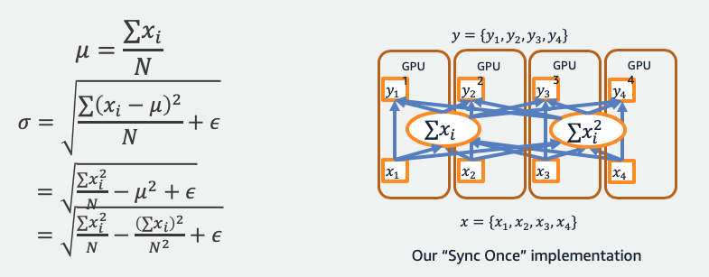
Implement SOTA Segmentation Models with GluonCV
Synchronized BatchNorm(”Sync once”)
⁴Zhang, Hang, et al. "Context encoding for semantic segmentation." The IEEE Conference on Computer Vision and Pattern Recognition (CVPR). 2018.

Slide 22
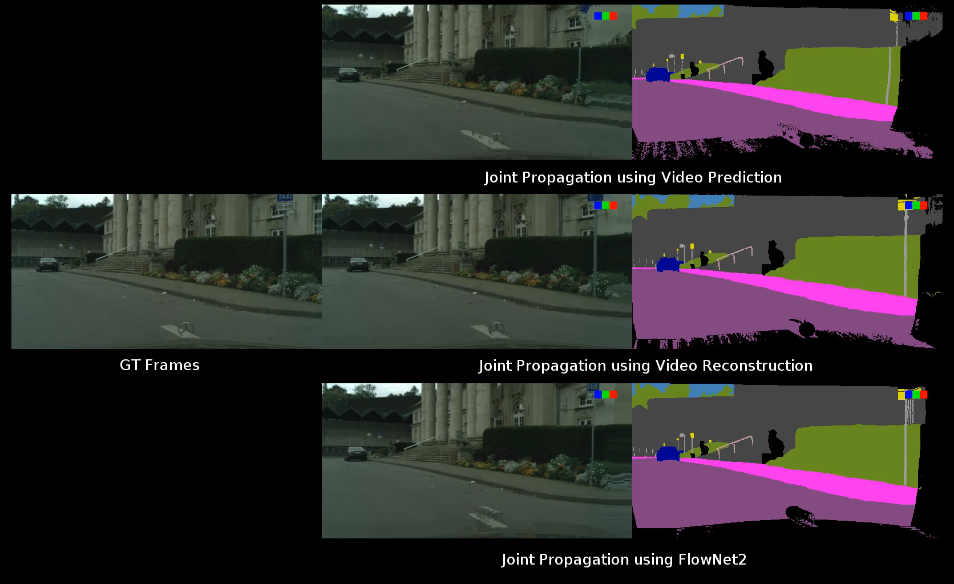

Implement SOTA Segmentation Models with GluonCV
Cityscapes Synthesized Training Samples
Joint Propagation using video prediction
Propagation [t-5, t+5]
GT frames
Joint Propagation using VPLR Approach
synthesized samples
Joint Propagation using Flownet2
⁵Zhu, et al. "Improving Semantic Segmentation via Video Propagation and Label Relaxation." The IEEE Conference on Computer Vision and Pattern Recognition (CVPR). 2019.

Slide 23

Implement SOTA Segmentation Models with GluonCV
More robust visualization results
⁵Zhu, et al. "Improving Semantic Segmentation via Video Propagation and Label Relaxation." The IEEE Conference on Computer Vision and Pattern Recognition (CVPR). 2019.

Slide 24
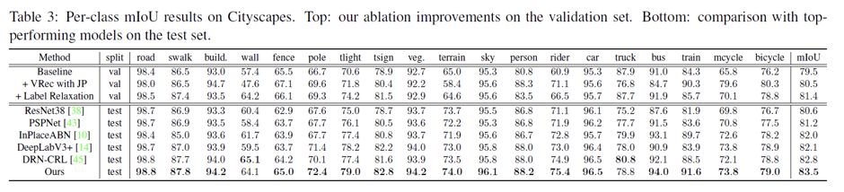
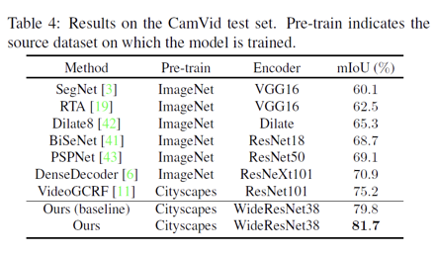
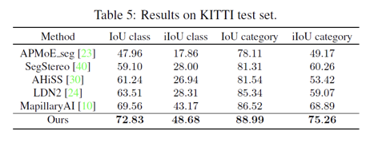
Implement SOTA Segmentation Models with GluonCV
⁵Zhu, et al. "Improving Semantic Segmentation via Video Propagation and Label Relaxation." The IEEE Conference on Computer Vision and Pattern Recognition (CVPR). 2019.

Slide 25
Hands On!

Slide 26

Like GluonCV? Go build!
https://github.com/dmlc/gluon-cv
https://gluon-cv.mxnet.io

